Slide 1
NOMURA GLOBAL MARKETS’ WOMEN MENTORSHIP PROGRAM
AYUSHI MEHTA
IIT KANPUR

Slide 2

HIGHLIGHTS OF THE MENTORSHIP PROGRAM
Delved into the world of finance especially stock markets under the esteemed guidance of experienced professionals at Nomura.
Researched and worked on two projects :
1. Pricing European Options using Monte Carlo Simulations
2. Equity Markets

Slide 3
PRICING EUROPEAN OPTIONS USING MONTE CARLO SIMULATIONS

Slide 4
MONTE CARLO SIMULATIONS
It is a powerful computational technique used to forecast future stock prices by generating numerous possible price paths.
It involves random sampling and statistical modeling to account for the uncertainty in stock price movements.
By simulating a wide range of potential outcomes, analysts can better understand the possible future behaviors of stock prices, assess risks, and make more informed investment decisions.

Slide 5
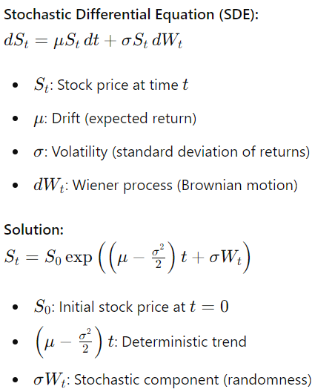
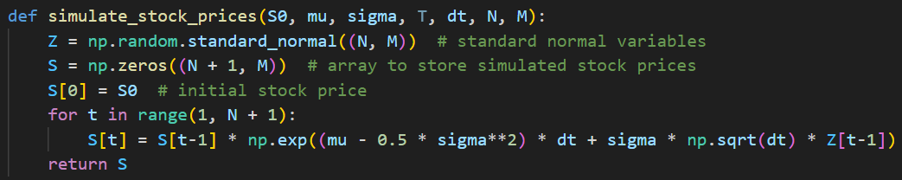
GEOMETRIC BROWNIAN MOTION
Assuming that stock price follow a lognormal distribution where the stock returns follow a normal distribution, we simulate the stock prices using the Geometric Brownian motion equation.

Slide 6
PAYOFF AT MATURITY
Definition: The payoff at maturity for options refers to the amount of money an investor gains or loses when an options contract expires, based on the difference between the market price of the underlying asset and the option's strike price.
There are two kinds of options ‘Call Option’ and ‘Put Option’ and the formula for calculating payoff at maturity varies slightly for both of them.

Slide 7
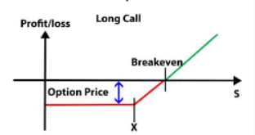



CALL OPTION
Definition: A call option gives the holder the right, but not the obligation, to buy an underlying asset at a specified strike price on or before the option's expiration date.
Payoff Formula:
Formula for pricing a European Call Option:

Slide 8
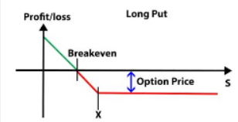




PUT OPTION
Definition: A put option gives the holder the right, but not the obligation, to sell an underlying asset at a specified strike price on or before the option's expiration date.
Payoff Formula:
Formula for pricing a European Put Option:

Slide 9

SIGNIFICANCE OF FORMULA USED FOR PRICING A EUROPEAN OPTION
The term represents the average expected payoff of the option at maturity, considering the randomness in stock price movements.
This factor accounts for the time value of money. Money today is worth more than the same amount in the future due to the potential earning capacity. By discounting the expected payoff at the risk-free rate, we determine what that future payoff is worth in today's terms.

Slide 10
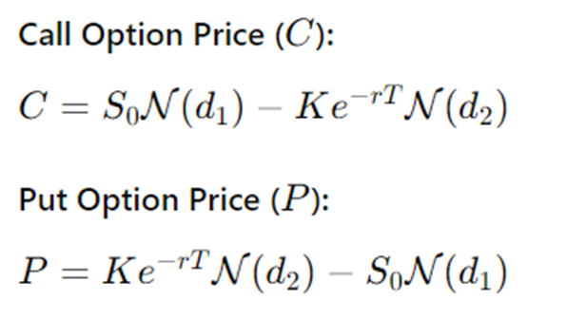
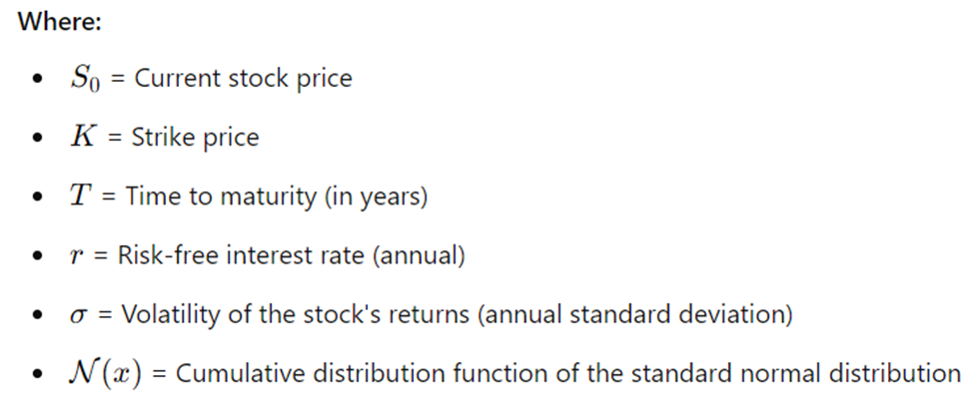
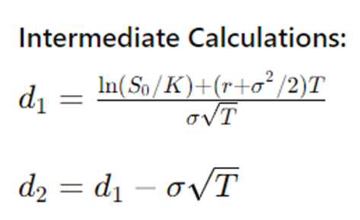

BLACK-SCHOLES FORMULA FOR EUROPEAN OPTIONS
The Black-Scholes formula provides a theoretical estimate of the price of European-style options, which can only be exercised at expiration.

Slide 11
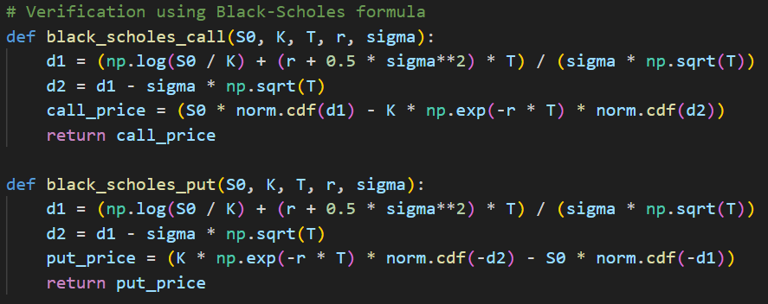
CODE SNIPPET FOR VERIFICATION USING BLACK-SCHOLES FORMULA

Slide 12
RESULT
Values taken - K : 90, T : 0.5
The price of the European call option is: 14.57
The price of the European put option is: 3.66
Verified call price using Black-Scholes formula: 14.58
Verified put price using Black-Scholes formula: 3.69

Slide 13
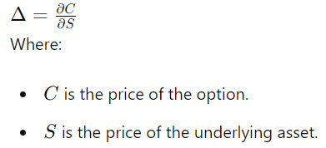
DELTA
Definition:
Delta measures the sensitivity of an option's price to changes in the price of the underlying asset. It represents the rate of change of the option's price with respect to a one-unit change in the underlying asset's price.
Formula:

Slide 14
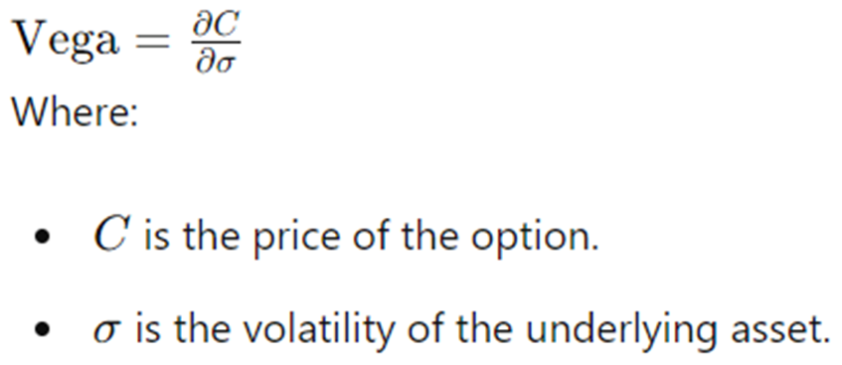
VEGA
Definition:
Vega measures the sensitivity of an option's price to changes in the volatility of the underlying asset. Specifically, it quantifies how much the price of an option will change with a 1% change in the volatility of the underlying asset.
Formula:

Slide 15

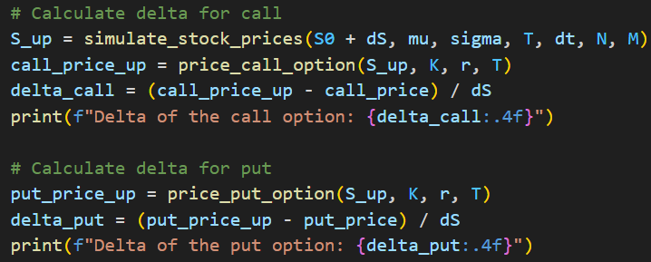
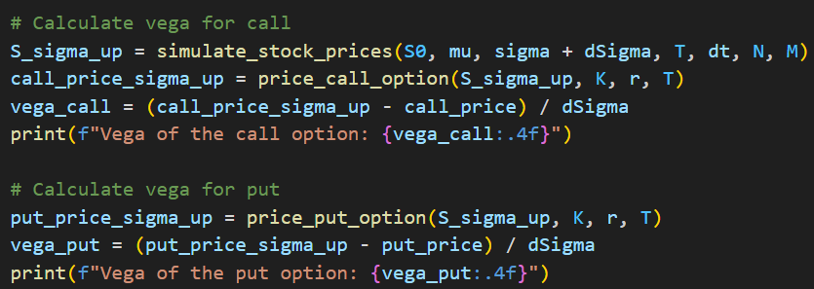
CODE SNIPPETS FOR DELTA AND VEGA

Slide 16
CALCULATED VALUES OF DELTA AND VEGA
Values taken - K : 90, T : 0.5
Delta of the call option: 0.7469
Delta of the put option: -0.2177
Vega of the call option: 28.2172
Vega of the put option: 36.5257

Slide 17

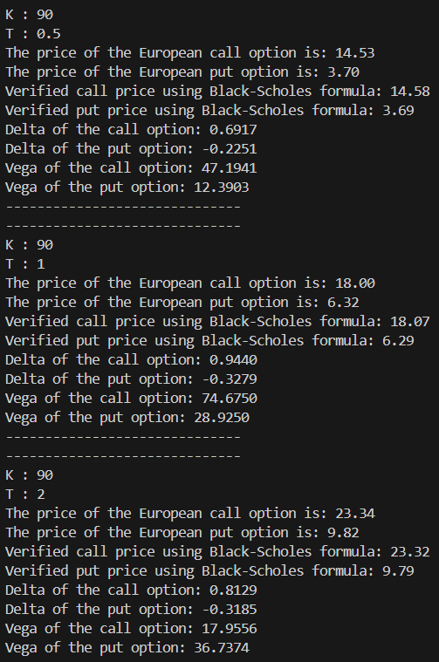
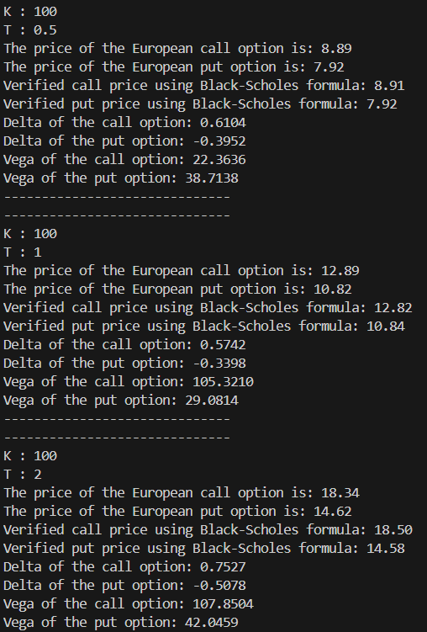
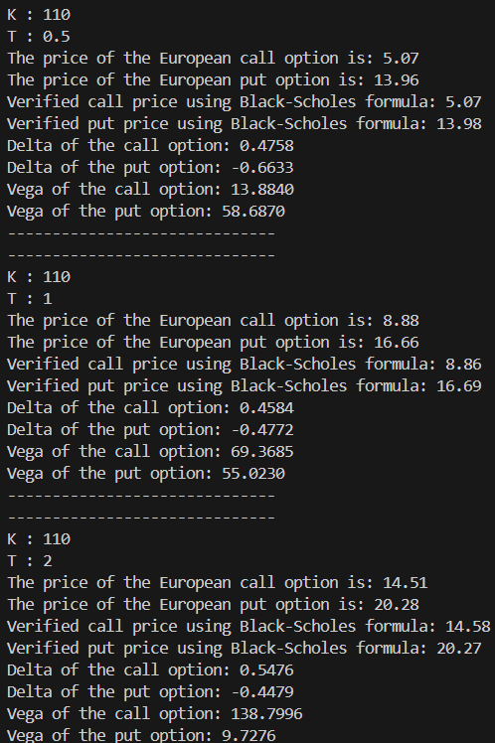
USING DIFFERENT STRIKES AND TENOR

Slide 18
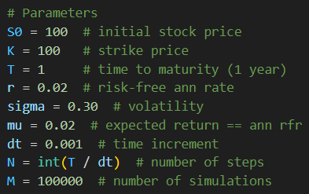
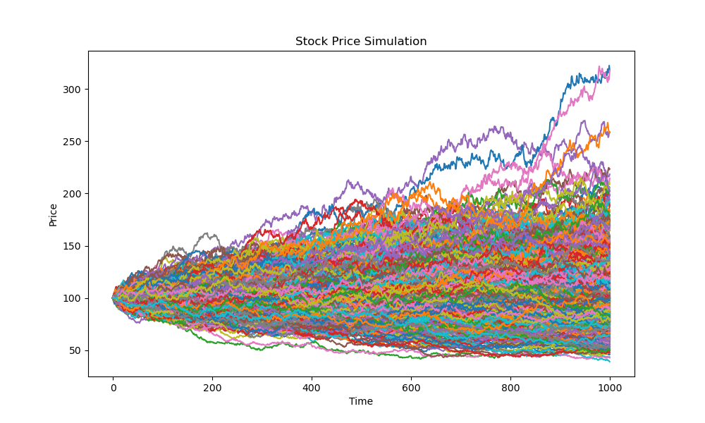
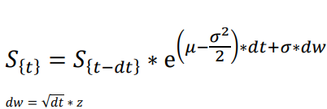
VISUALIZING SIMULATIONS
Parameters Used
Stochastic GBM Equation

Slide 19
EQUITY MARKETS

Slide 20

DEFINITION
Equity markets, also known as stock markets or share markets, are platforms where shares of publicly traded companies are bought and sold.
These markets enable investors to purchase ownership stakes in companies, which are represented by shares of stock.
The main functions of equity markets include providing companies with access to capital and giving investors the opportunity to participate in the financial performance of those companies.

Slide 21
NIFTY 50 INDEX
The NIFTY 50 is a stock market index representing the weighted average of 50 of the largest and most liquid Indian companies listed on the National Stock Exchange of India (NSE).
It serves as a benchmark index for the Indian equity market, providing a measure of the overall performance of the market and the economy.

Slide 22
TOP 10 LARGE CAP STOCKS IN NIFTY 50 INDEX TAKEN (AS ON 15.04.2024)
BAJFINANCE
HDFCBANK
ICICIBANK
INFY
ITC
KOTAKBANK
LT
RELIANCE
SBIN
TCS

Slide 23
BETA OF A STOCK
Definition: Beta (β) is a measure of a stock's volatility or systematic risk in comparison to the overall market. It indicates how much the stock's price is expected to move relative to market movements. A beta value can help investors understand the risk associated with a particular stock in the context of the market.
Interpretation of Beta Values:
β = 1: The stock's price is expected to move in line with the market.
β > 1: The stock is more volatile than the market. For example, a beta of 1.5 means the stock is expected to be 50% more volatile than the market.
β < 1: The stock is less volatile than the market. For example, a beta of 0.5 means the stock is expected to be 50% less volatile than the market.
β = 0: The stock's price is not correlated with the market movements.
β < 0: The stock moves in the opposite direction to the market.

Slide 24
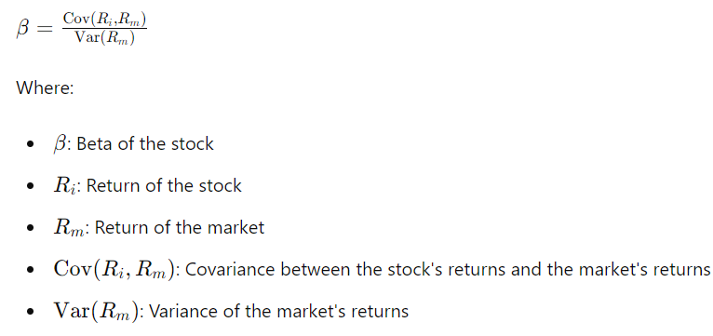
CALCULATING BETA
Using Formula:
Using Linear Regression: Slope of the best-fit line in the plot of ‘Return of Stock VS Return of Market’

Slide 25
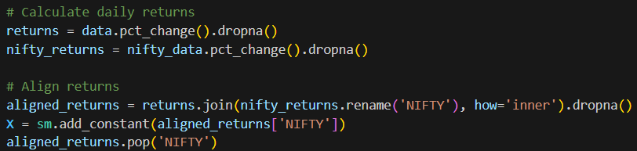
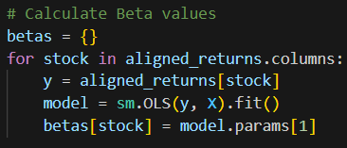
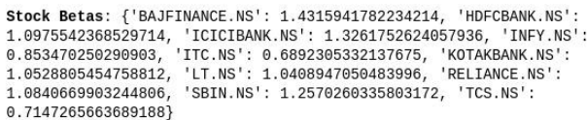
PYTHON CODE AND OUTPUT
Calculating Returns:
Calculating Beta values of each stock:
Output:

Slide 26
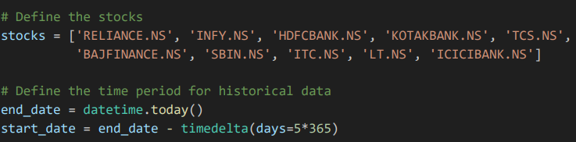
SELECTION OF TIME FRAME
The choice of time period for calculating Beta, expected returns using CAPM, and constructing the efficient frontier is pivotal.
A common approach is to use the last 5 years of returns.
This period is long enough to capture a variety of market conditions, including bull and bear markets, yet recent enough to be relevant to current conditions.

Slide 27
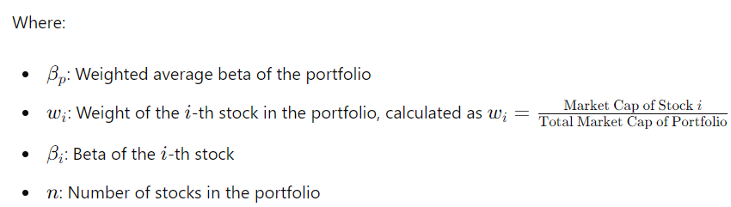

WEIGHTED AVERAGE BETA OF A PORTFOLIO
Determine the Market Capitalization Weights: Calculate the weight of each stock in the portfolio based on its market capitalization relative to the total market capitalization of all stocks in the portfolio.
Calculate the Weighted Beta: Multiply each stock's beta by its corresponding weight.
Sum the Weighted Betas: Add up all the weighted betas to get the portfolio's weighted average beta.

Slide 28
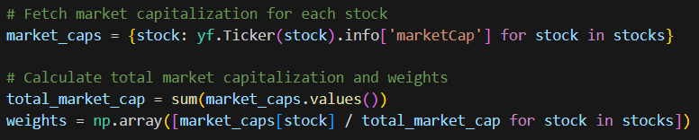
PYTHON CODE AND OUTPUT
1. Calculating Weights
using Market
Capitalization
2. Calculating
Portfolio Beta
Output

Slide 29
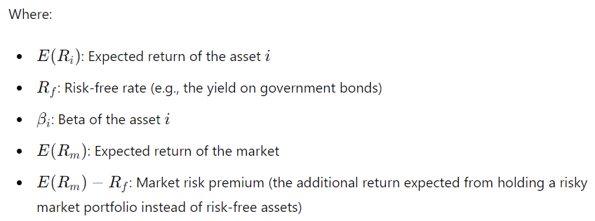

CAPITAL ASSET PRICING MODEL (CAPM)
Definition: The Capital Asset Pricing Model (CAPM) is a financial model used to determine the expected return of an asset based on its systematic risk (beta), the risk-free rate, and the expected market return. The CAPM formula is used to calculate the expected return of an asset or a portfolio of assets.

Slide 30

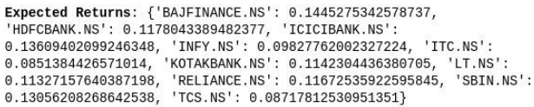
PYTHON CODE AND OUTPUT
Calculating expected returns of each stock
Calculating Portfolio expected return
Outputs:

Slide 31

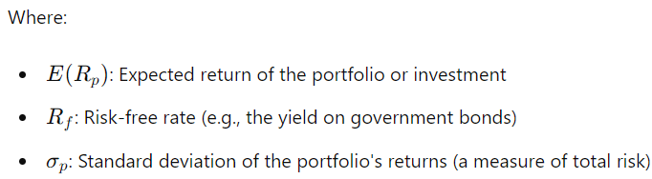
SHARPE RATIO
Definition: The Sharpe Ratio is a measure of risk-adjusted return. It indicates how much excess return an investment generates for each unit of risk taken. The higher the Sharpe Ratio, the better the investment's risk-adjusted performance.

Slide 32

EXPLANATION OF FORMULA
Excess Return : This represents the return of the portfolio above the risk-free rate. It's the additional return earned for taking on risk.
Standard Deviation : This measures the volatility or risk of the portfolio's returns. It captures the degree to which the portfolio's returns can vary.
Risk-Adjusted Performance: By dividing the excess return by the standard deviation, the Sharpe Ratio provides a way to compare investments on a risk-adjusted basis. Investments with higher Sharpe Ratios offer better risk-adjusted returns.

Slide 33
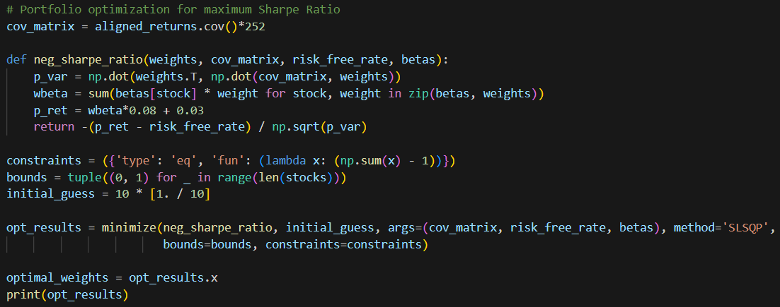

FINDING OPTIMAL WEIGHTS
Output :

Slide 34
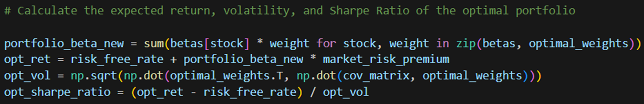

CALCULATIONS FOR THE OPTIMAL PORTFOLIO
Output :

Slide 35
EFFICIENT FRONTIER
The efficient frontier is a concept in modern portfolio theory introduced by Harry Markowitz.
It represents a set of optimal portfolios that offer the highest expected return for a defined level of risk or the lowest risk for a given level of expected return.
These portfolios are considered efficient because no other portfolio can provide a better risk-return combination.

Slide 36
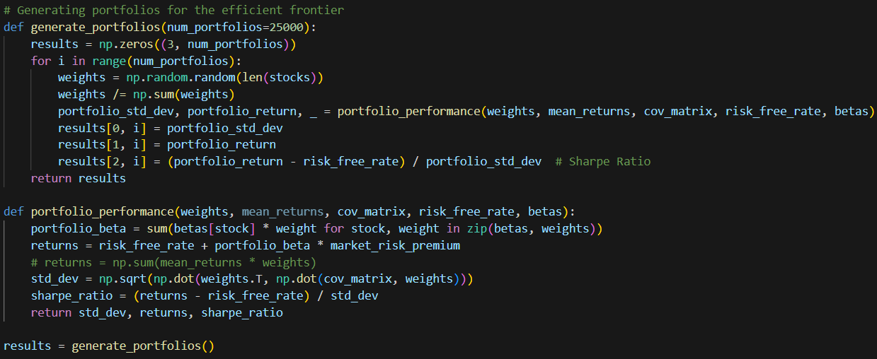
GENERATING PORTFOLIOS FOR THE EFFICIENT FRONTIER

Slide 37
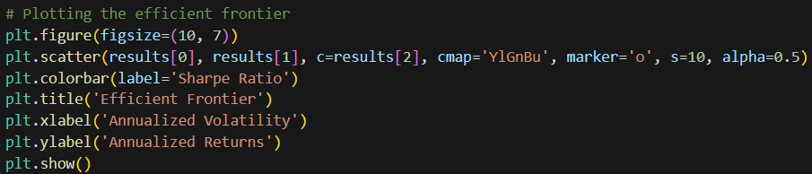
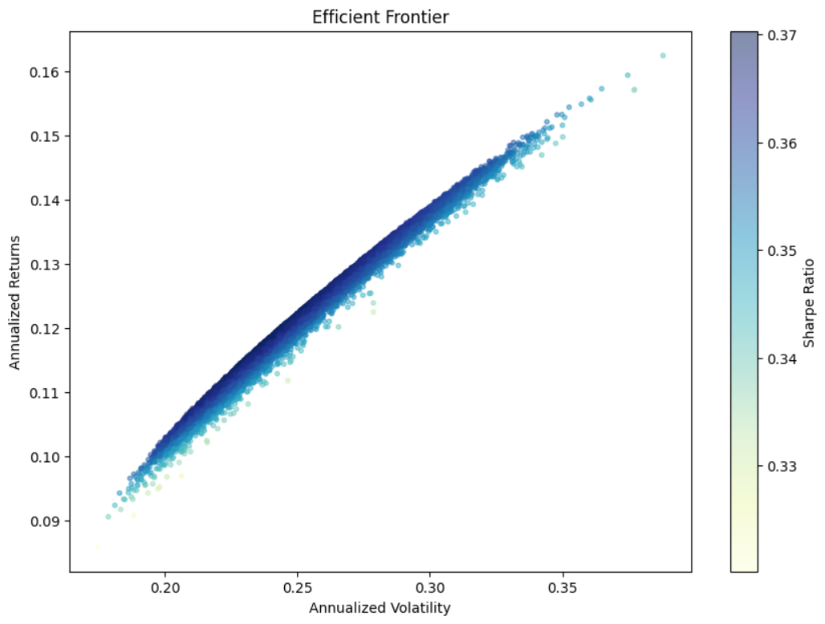
PLOTTING EFFICIENT FRONTIER

Slide 38
THANK YOU

